Slide 1
Why document levels of service?
Notes:
Audience: Local government staff presenting to elected officials.
Target local governments: Small to mid-size, early in their asset management journey.
Applicability: All local governments across Canada tackling Levels of Service.
Intent and direction:
This slide deck is intended to assist you with generating buy-in for documenting Levels of Service (LOS) by supporting your communication with elected officials in particular.
Customization:
You’re encouraged to edit the slides as needed, and either incorporate them into a broader presentation or use the content as you prepare a council briefing related to LOS as part of your asset management journey.
Helpful context as part of an introduction to LOS would be to highlight your local government’s asset management journey to date, key milestones, or priorities.
Speaking notes:
Let’s walk through the importance of defining and measuring the levels at which we provide service.
This resource was produced by the Municipal Asset Management Program, which is delivered by the Federation of Canadian Municipalities (FCM) and funded by the Government of Canada.
© 2024. Federation of Canadian Municipalities. All rights reserved.

Slide 2
We document levels of service to… Bring our community’s vision into focus
Notes:
Intent and direction:
The intent of this slide is to convey that as a service delivery organization we want to ensure that we’re meeting the needs of our customers by achieving our local government’s vision.
How do we achieve our vision through our day to day activities? By documenting LOS and measuring performance.
Customization:
Consider sharing your local government’s vision.
Speaking notes:
Levels of service are specific parameters that describe and measure the extent and quality of services that the local government provides to stakeholders.
We want to capture the community-wide experience of our customers as they use the varied local government services to determine if we’re effectively meeting the needs of our customers.
To do that we need to be able to measure how we’re providing those services.
Since our local government’s vision was created to respond to the needs of our residents and businesses, by documenting and measuring levels of service we’re bringing our community’s vision into focus.

Slide 3
The fundamental purpose of local government is…
Service delivery
Notes:
Intent and direction:
The intent of this slide is to reinforce the role of local government as a service delivery organization.
The type and scope of these services vary by local government.
There are often regulatory minimums that must be met.
Customization:
Consider updating the image on this slide to reflect the services that your local government provides.
Speaking notes:
Local governments are customer-centric organizations, and our fundamental purpose is to provide services to our customers. These services have a direct impact on the daily lives and wellbeing of residents and businesses.
Although the suite of services are unique for each local government, we all rely on infrastructure and natural assets to support the delivery of these services. As a responsible service provider, we have an obligation to care for the assets and amenities that provide our customers with service.
By focusing on LOS we are encouraged to develop innovative approaches that can drive down the whole life cost of delivering services.

Slide 4
Consider
What are the major services that we provide?
How are we measuring our service delivery performance? Do these services meet the needs of our community?
Do these services align with the long-term vision for our community?
Notes:
Intent and direction:
The intent of this slide is to consider the reasons why documenting and measuring LOS is important.
Each question appears individually to encourage reflection.
And if you asked Council, customers or staff what would they say?
Customization:
Consider using these questions as a guide for a workshop, or discussion, that can help facilitate buy-in for the LOS process.
This could include brainstorming the services you provide (note: this should be focused on the major services so steer the discussion towards drinking water, wastewater, transportation and mobility, etc.)
Note that there may be variations in the responses for questions 2-4 by service area.
Be prepared with your vision, as participants will want a copy to reference.
If you’ve done any consultation for a strategic plan update, community plan update, for specific master plans, or centered around satisfaction with service delivery then have a copy of the results for reference.
If you have a neighbourhood equity index, guide or have done other background work also bring a copy of that for sharing.
Speaking notes:
Let’s pause and think about our own service delivery for a minute. I encourage you to answer these questions in your head. We’ll walk through them one by one as they come up on the screen.
1) What are the major services that we provide as a local government (eg. drinking water, wastewater, etc.)?
2) How are we measuring service delivery performance? Do these services meet the needs of our community?
3) Do these services align with the long term vision for our community?
4) Are services being delivered equitably across our community? Think about user groups, wards/districts/neighbourhoods.
5) Are the day-to-day activities of our staff consistent with the services provided? The community’s vision?
I think we can fairly say that we don’t know the answers to all these questions. So, how do we find answers that align with our fundamental responsibilities as a local government?

Slide 5
Are services being delivered equitably across our community?
Are the day-to-day activities being undertaken by staff aligned with the services provided and the community’s vision?
Notes:
Intent and direction:
The intent of this slide is to consider the reasons why documenting and measuring LOS is important.
The questions come up one at a time to give listeners an opportunity to pause and think.
And if you asked Council, customers or staff what would they say?
Customization:
Consider using these questions as a guide for a workshop, or discussion, that can help facilitate buy-in for the LOS process.
This could include brainstorming the services you provide (note: this should be focused on the major services so steer the discussion towards drinking water, wastewater, transportation and mobility, etc.)
Note that there may be variations in the responses for questions 2-4 by service area.
Be prepared with your vision, as participants will want a copy to reference.
If you’ve done any consultation for a strategic plan update, community plan update, for specific master plans, or centered around satisfaction with service delivery then have a copy of the results for reference.
If you have a neighbourhood equity index, guide or have done other background work also bring a copy of that for sharing.
Speaking notes:
Let’s pause and think about our own service delivery for a minute. I encourage you to answer these questions in your head. We’ll walk through them one by one as they come up on the screen.
1) What are the major services that we provide as a local government (eg. drinking water, wastewater, etc.)?
2) How are we measuring service delivery performance? Do these services meet the needs of our community?
3) Do these services align with the long term vision for our community?
4) Are services being delivered equitably across our community? Think about user groups, wards/districts/neighbourhoods.
5) Are the day-to-day activities of our staff consistent with the services provided? The community’s vision?
I think we can fairly say that we don’t know the answers to all these questions. So, how do we find answers that align with our fundamental responsibilities as a local government?

Slide 6
Why document levels of service?
To translate community expectations and objectives into more specific direction for a service area.
To measure our service delivery performance with practical or measurable indicators.
To replace subjective decisions with transparent, fact-based decisions.
Levels of service is an accountability tool.
Notes:
Intent and direction:
The intent of this slide is to respond to the questions we considered on the previous slide, solidifying why it’s important to document and measure our levels of service.
Customization:
Consider adding a local photo.
Speaking notes:
We document service levels to translate community expectations and Council objectives into clear directions for service areas. This allows us to measure our service delivery performance in a realistic way. It also replaces subjective decisions with transparent, fact-based decisions.
We can think of LOS as a contract between the Council and the public. So, providing good service is not enough. We must also demonstrate the quality of service provided. In doing so, we’re able to use LOS as an accountability tool.

Slide 7
If we do not document and measure levels of service…
Elected officials
Staff
Public
Will not know what services they can realistically provide, so decisions tend to be subjective or broadly applied
Can become focused on their day-to-day tasks, and lose sight of why these tasks are important
Has expectations, but doesn’t understand the bigger picture, so feedback becomes complaint-based and localized
Notes:
Intent and direction:
The intent of this slide is to communicate the implications of making decisions subjectively, instead of relying on facts, from the perspective of key local government decision makers, implementers and stakeholders.
Customization:
Consider adjusting the terminology to suit your own local government.
Think about the audience of your presentation. It may be helpful to share examples or tell stories here.
If this is workshop-based, it’s also an opportunity for more critical thinking.
Speaking notes:
While most local governments know intuitively what services they provide, few have a method for clearly documenting and communicating this to users/customers. Without this documentation, it means that:
Elected officials are stewards over the organization that provides services. But, they don’t necessarily know the level at which they can realistically provide services, and as a result decisions tend to be subjective or broadly applied.
Think about: how we can have conversations around cost of service, and make trade-offs, to support strong decision making.
Staff manage, operate, maintain, and deliver the services that local government provides. When they become focused on their day-to-day tasks, it’s possible to lose sight of why these tasks are important. We want staff to feel like they’re an integral part of our ability to achieve our vision – because they are!
Think about: how staff can connect day-to-day activities to the community’s vision.
Our residents, business owners and other stakeholders have expectations, but don’t necessarily understand the bigger picture, so feedback becomes complaint-based and localized.
Think about: how we can solicit meaningful feedback about the adequacy of services, as well as what services is the public willing and able to pay for.
Defining and documenting service levels enables us to translate community expectations into more specific direction for a service area. It stands to reason that we should be accountable to our customers (reporting performance trends over time) and checking in with them to ensure our services still meet their needs.

Slide 8
Benefits of establishing and documenting levels of service
Ensuring consistency between our goals as a local government and the daily activities of our staff.
Inspiring staff to improve productivity through a more engaged workforce.
Measuring how well we’re working towards our vision, and whether we’re delivering the services that our customers need and expect.
Notes:
Intent/Direction:
The intent of this slide is to reinforce the benefits of having defined and documented levels of service, but also being able to measure performance over time.
Customization:
Consider what’s going to stand out to your audience, and highlight those benefits in particular.
Speaking notes: Establishing and documenting levels of service will enable us to create alignment between what we’re trying to achieve as a local government and what our staff are doing on a day-to-day basis. When staff have a clear understanding of their purpose, it can lead to increased productivity and a more engaged workforce. We can measure how well we’re working towards our vision in order to deliver the services our customers need and expect. This is critical to support our decision-making process. We can assess expectations against what’s affordable (within our budget) and understand the impact of delivering service at a particular level to our customers.

Slide 9
Clarifying expectations for our customers, including what services we are not providing, and why.
Assessing expectations against what’s affordable. (within our budget)
Assessing changing demands – there may be a need to shift the services we provide, or the levels at which we provide them.
Notes:
Intent/Direction:
The intent of this slide is to reinforce the benefits of having defined and documented levels of service, but also being able to measure performance over time.
Customization:
Consider what’s going to stand out to your audience, and highlight those benefits in particular.
Speaking Notes: If the public doesn’t know what we’re committed to, how can we be clear on our strategies for getting there? This LOS process enables us to set clear expectations for our customers, including being able to communicate what services we are not providing, and why. We can then follow through with actions, and measure effectiveness over time. Our LOS process can also enable us to assess where demands are changing. There may be a need to shift the services we provide, or the levels at which we provide them, based on community needs.

Slide 10
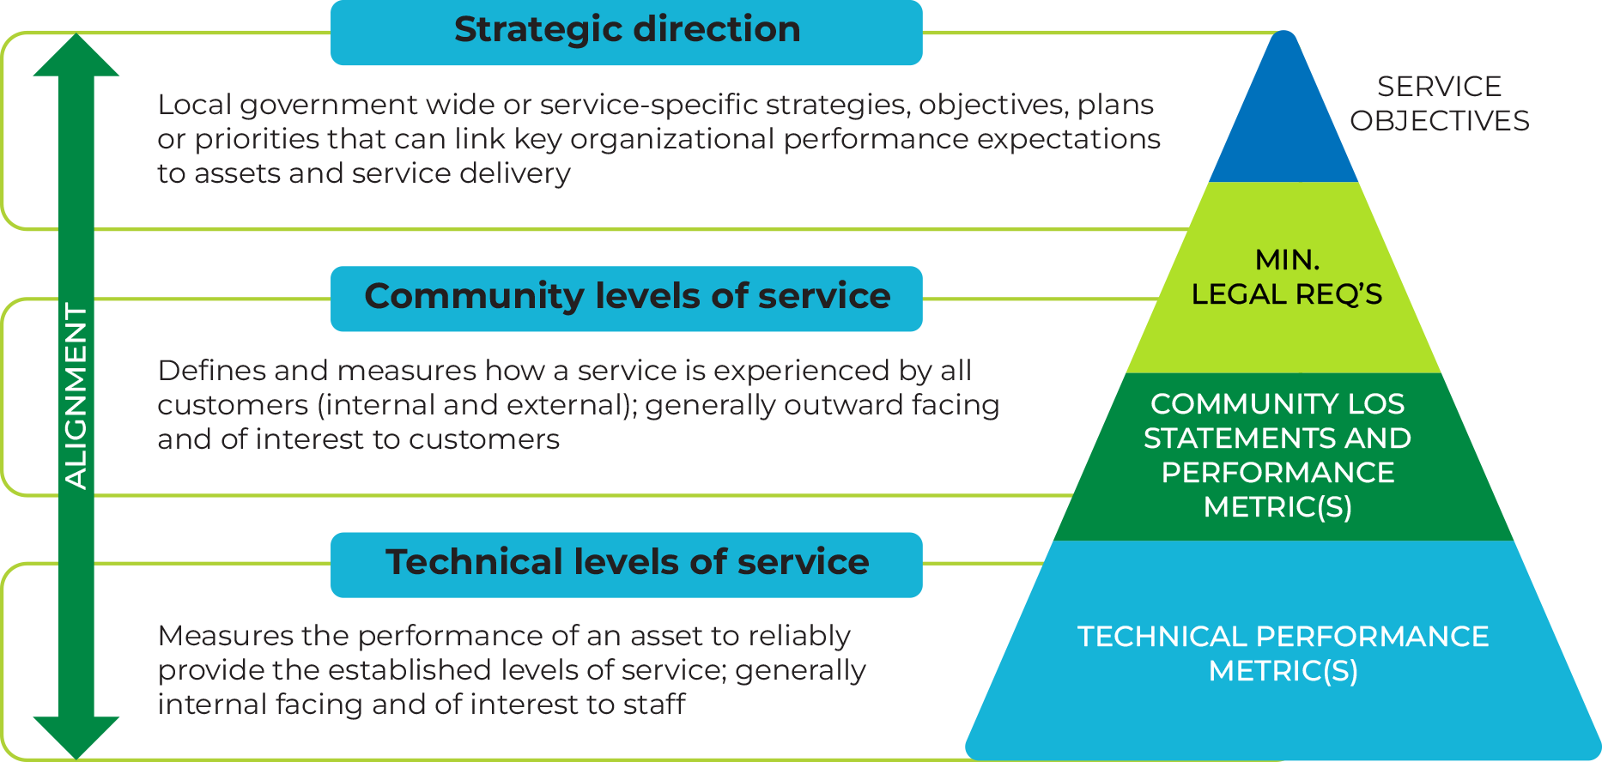
Notes:
Intent/Direction:
The intent of this slide is distinct and focuses on the continuous balancing act of service delivery.
Customization:
Highlight the balance between community needs, costs, risks, and performance.
Speaking Notes: It’s a continuous balancing of community needs with the costs of providing service, the risks of not providing service at an expected level, and our service delivery performance. This isn’t new for us. We’ve been providing services for generations. This is an opportunity to align and streamline service delivery.

Slide 11
Glossary of terms
Reconciliation & Anti Racism, Equity and Inclusion (R+AREI) –
Reconciliation – is the process of repairing and strengthening relationships between Indigenous and non-Indigenous communities. It addresses historical injustices, while encouraging communities to together towards a shared future.
Anti-racism – is an ongoing practice and process involving raising one’s awareness of race, racialization, and racism and taking action when you recognize racism is at play in yourself, community, and workplace.
Equity – is a principle and process that promotes fair conditions for all persons to fully participate in society.
Inclusion – refers to creating, fostering, and sustaining systems, practices and conditions that enable people of different backgrounds and identities to feel respected, valued, and a sense of belonging.
Notes:
Speaking notes:
This glossary is intended to provide clear and concise definitions of important terms related to Levels of Service (LOS). It can be used as a reference tool during discussions, presentations, and training sessions to ensure that all stakeholders have a shared understanding of key concepts.

Slide 12
Customer LOS – define and measures how a service is experienced by all customers (internal and external); generally outward facing and of interest to customers.
Distributional analysis – a spatial method used to evaluate how services are delivered across different parts of the community.
Levels of service (LOS) – specific parameters that describe and measure the extent and quality of services provided by the local government to stakeholders.
Strategic direction – local government wide or service-specific strategies, objectives, plans or priorities (to link key organizational performance expectations to assets and service delivery).
Technical LOS – measure the established level at which the asset is capable of providing service; generally internal facing and of interest to staff.
Notes:
Speaking notes:
This glossary is intended to provide clear and concise definitions of important terms related to Levels of Service (LOS). It can be used as a reference tool during discussions, presentations, and training sessions to ensure that all stakeholders have a shared understanding of key concepts.

Slide 13
Thank you.
This presentation was developed through the Municipal Asset Management Program, which is delivered by the Federation of Canadian Municipalities and funded by the Government of Canada.

